Slide 1
Chapter 3
The Project Manager

Slide 2
The Project Manager
The project manager can be chosen and installed as soon as the project is selected for funding
  This simplifies several start up activities
The project manager can be chosen later
  This makes things difficult
Senior management briefs the project manager
Project manager begins with a budget and schedule
  As people are added these are refined
3-<number>

Slide 3
Functional Management
Department heads are usually functional specialists
They have the required technical skills to evaluate all members of their organization
Functional managers:
  Decide who performs each task
  Decide how the task is performed
  Exercise a great deal of control over every aspect of the work that gets performed within their area
3-<number>

Slide 4
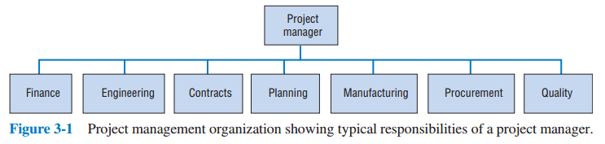
Project Management (Slide 1 of 2)
3-<number>

Slide 5
Project Management (Slide 2 of 2)
Project managers are usually generalists
It would be very unusual for a project manager to have all the technical skills that are used on their projects
Project managers:
  Rarely decide who performs each task
  Lack the technical skills to evaluate much of the work performed on a particular project
  Exercise control very little over most aspects of the work that gets performed on the project
3-<number>

Slide 6
Comparing Functional & Project Managers
Functional Managers | Project Managers
need technical skills | need negotiation skills
should be more skilled at analysis | should be more skilled at synthesis
use the analytic approach | use systems approach
responsible for a small area | responsible for the big picture
act as managers | act as facilitators
responsible for a small area | responsible for the big picture
act as direct, technical supervisors | act as facilitators and generalists
3-<number>

Slide 7
Three Major Questions Facing Project Managers
What needs to be done?
When must it be done?
How are the resources required to do the job to be obtained?
3-<number>

Slide 8
Project Manager Responsibilities
The parent organization
The project and the client
The project team
3-<number>

Slide 9
The Parent Organization
Proper usage of resources
Timely and accurate reports
  Covered in detail later
Keep project sponsor informed
3-<number>

Slide 10
The Project and the Client
Preserve the integrity of the project
  This may be difficult with all sides wanting changes
Keep the client informed of major changes
3-<number>

Slide 11
The Project Team
Very few people will work for the project manager
The “team” will disband at the end of the project
The project manager must look out for everyone’s future
  This is in the best interest of the project, otherwise as the project winds down, everyone will be looking after themselves
3-<number>

Slide 12
Project Management Career Paths
Might work on several projects simultaneously
Small short-term projects train new project managers
Start on small projects and work up to large projects
Experience as a project manager is often seen as a desirable step on the corporate ladder
3-<number>

Slide 13
Sample Career Path
Trainee:
  a six-month position to learn about project management
Cost Analysis/Schedule Engineer:
  a 6–18 month team position reporting to a project manager
Site Manager:
  a 6–12 month position responsible for a large site and reporting to a program manager
Small Project Manager:
  sole responsibility for a $1M to $3M revenue project
Project Manager:
  responsible for $3M to $25M projects
Program Manager:
  responsible for multiyear projects and programs over $25M
3-<number>

Slide 14
Special Demands on the Project Manager
Acquiring adequate resources
Acquiring and motivating personnel
Dealing with obstacles
Making project goal trade-offs
Maintaining a balanced outlook
Breadth of communication
Negotiation
3-<number>

Slide 15
Acquiring Adequate Resources
Project budgets are usually inadequate
Resource trade-offs must be considered
Crises occur that require special resources
Availability of resources is seen as a “win-lose” proposition
3-<number>

Slide 16
Acquiring and Motivating Personnel
(Slide 1 of 2)
Most project workers are borrowed from functional managers
The project manager negotiates for the desired worker but
  the project manager wants the best qualified individual
  the functional manager decides who to assign
3-<number>

Slide 17
Acquiring and Motivating Personnel (Slide 2 of 2)
The functional manager also decides:
  the skill level to assign
  the pay and promotion of the worker
Worker will most likely return to the functional manager once the project is finished
Once workers are assigned to a project, the project manager must motivate them
  The project manager has little or no control over pay and promotion
3-<number>

Slide 18
Most Important Characteristics for Team Members
High-quality technical skills
Political, and general, sensitivity
Strong problem orientation
Strong goal orientation
High self-esteem
3-<number>

Slide 19
Tuckman Ladder
Teams progress through four development phases:
  Forming
  Storming
  Norming
  Performing
  Adjourning has been suggested also
3-<number>

Slide 20
Dealing with Obstacles (Slide 1 of 2)
Every project is unique
The project manager should be ready to face a series of crises
A big problem is “scope creep”
Good project managers are fire preventers hopefully, but also fire fighters
3-<number>

Slide 21
Dealing with Obstacles (Slide 2 of 2)
Early problems are associated with resources
Later problems are associated with:
  Last-minute schedule and technical changes
  The happenings to a team when the project is completed
3-<number>

Slide 22
Making Project Goal Trade-Offs
Project managers must make trade-offs between the project goals of:
  Cost
  Time
  Scope
  Ancillary goals
Multiple projects
Project goals and organizational goals
Project, firm, career
3-<number>

Slide 23
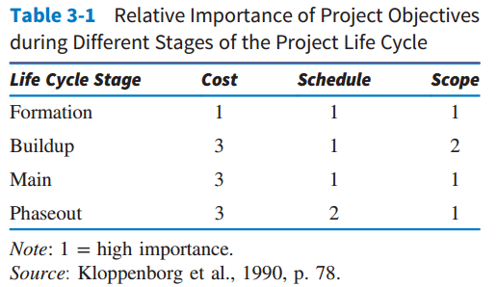
Relative Importance of Project Objectives
3-<number>

Slide 24
Maintaining a Balanced Outlook
Hard to tell where a project is headed
Outlook can change over the life of a project
Technical problems cause waves of pessimism and optimism
Mood swings can hurt performance
Maintaining a positive outlook is a delicate job
3-<number>

Slide 25
Breadth of Communication
Most of a project manager’s time is spent communicating
In order to properly communicate, the PM must deal with or understand:
  why the project exists
  that some projects fail
  that support of the top management is needed
  a strong information network is needed
  they must be flexible
3-<number>

Slide 26
Negotiations
Acquiring adequate resources
Motivating personnel
Dealing with obstacles
Making project goal trade-offs
Handing failure
Maintaining communication
3-<number>

Slide 27
Most Popular Attributes, Skills, and Qualities When Selecting PMs
Strong technical background
Hard-nosed manager
Mature
Currently available
On good terms with senior executives
Someone who can keep project team happy
Worked in several departments
Can walk on (or part) the waters
3-<number>

Slide 28
Attributes of Effective Project Managers
Credibility
Sensitivity
Leadership, ethics, and management style
Ability to handle stress
They must also have the drive to complete the task!
3-<number>

Slide 29
Credibility
Technical credibility
Administrative credibility
3-<number>

Slide 30
Sensitivity
Political sensitivity
Interpersonal sensitivity
Technically sensitivity
3-<number>

Slide 31
Leadership, Ethics, and Management Style
Leadership
  “a process of social influence, which maximizes the efforts of others, towards the achievement of a goal”
Strong sense of ethics
A management style that fits the project
3-<number>

Slide 32
Leadership Research
Conducted by PMI
Six skills identified for a project manager to become a leader:
  29% - communication
  26% - people
  16% - strategic
  12% - requirements gathering
  12% - leadership
  5% - time management
3-<number>

Slide 33
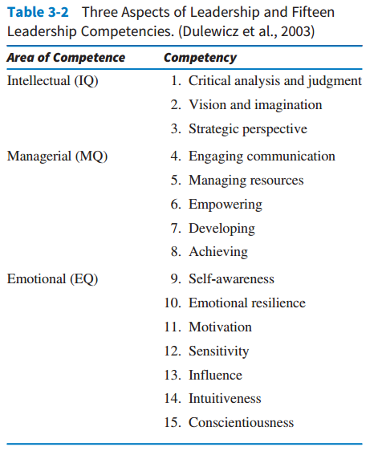
Leadership Competencies
3-<number>

Slide 34
Common Ethical Missteps in Business
“wired” bids and contracts
“buy-in”
kickbacks
“covering” for team members
taking “shortcuts”
using marginal materials
compromising on safety
violating standards
consultant loyalties
3-<number>

Slide 35
Ability to Handle Stress
Signs of excessive stress in workplace
  inability to switch-off work issues
  disturbed sleep
  lack of pleasure in non-work related leisure activities
  difficulty concentrating or making decisions
  tendency to anger quickly
  lack of energy
3-<number>

Slide 36
Ability to Handle Stress
No consistent procedures
Too much to do
High need to achieve
Organizations in change
3-<number>

Slide 37
Problems of Cultural Differences
Project managers must adapt to the social and cultural environment in which they are working
This is especially true when the project is in another country
Problems can arise in international projects, when a culture’s opinion of some group is different from that of the firm
3-<number>

Slide 38
Aspects of Culture
Technology
Institutions
Language
Art
3-<number>

Slide 39
Culture and the Project
Time
Staffing projects
Knowledge of people
3-<number>

Slide 40
Corporate Culture
Microcultures
Vary within industries and firms
Impacted by diversity
  Interindustry
  Interfirm
  Intrafirm
3-<number>

Slide 41
Copyright
Copyright © 2018 John Wiley & Sons, Inc.
All rights reserved. Reproduction or translation of this work beyond that permitted in Section 117 of the 1976 United States Act without the express written permission of the copyright owner is unlawful. Request for further information should be addressed to the Permissions Department, John Wiley & Sons, Inc. The purchaser may make back-up copies for his/her own use only and not for distribution or resale. The Publisher assumes no responsibility for errors, omissions, or damages, caused by the use of these programs or from the use of the information contained herein.
Copyright ©2018 John Wiley & Son, Inc.

